Slide 1
Miami, Florida
Traveling June 8-15 2013
Planned By:
Arya Sripadrao
$4579.00

Slide 2
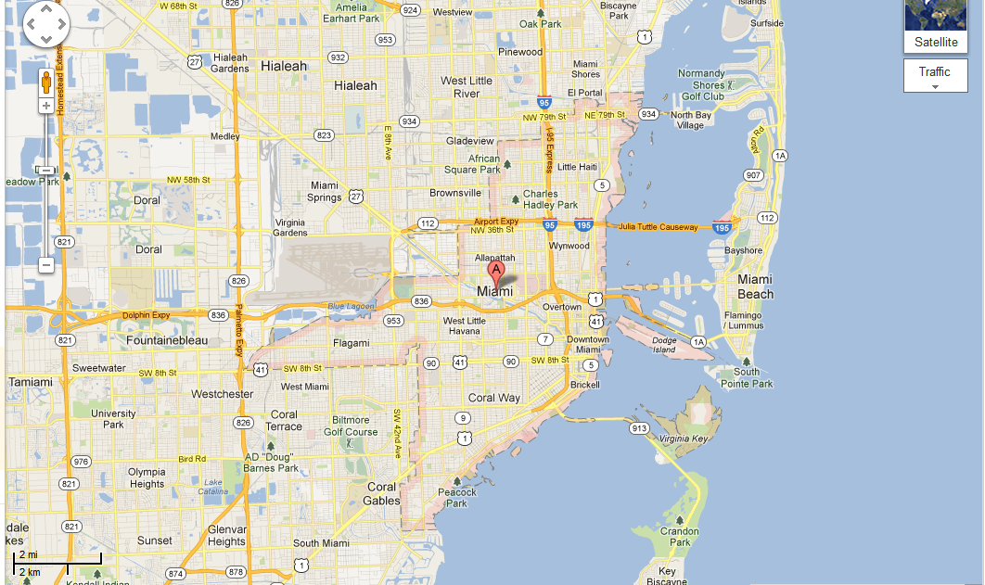
Map

Slide 3
Transportation
Transportation | Budget
Airfare x (family) | $1784.00
Airfare Parking at Airport | $50.
Car Rental | $0.00
Gas (going) [price x 25/ MPG] | $0.00
Gas (coming home) [price x 25/ MPG] | $0.00
Bus Tickets | $0.00
Train | $0.00
Other | $0.00
Total | $0.00
Figure out gas:
Find miles (google Maps)
Divide miles by 25
Take that number x gas price

Slide 4
Lodging
Lodging | Budget
Hotels $ x how many nights Sofitel Miami 120*6 Not staying in the same place? Sunday Monday Tuesday Wednesday Thursday Friday Saturday | $720.00
Other | $0.00
Total | $720.00

Slide 5
Extra Expense
Extra expenses | Budget
Souvenirs ($10.00 x 4 of people)10.00 x4 of purchases | $120.00
Snacks ($5.00 x #4 of people)5.00 x 4of purchases | $20.00
Emergency cash | $70.00
Total | $210.00

Slide 6
Itinerary
Total Expense: $432.00
Saturday, June 8th | Where | How Much?
Breakfast | Mc.Donalds 7x4 | $28.00
Activity | Miami Design District 18x4 | $72.00
Lunch | Soya & Pomodoro . 13x4 | $52.00
Activity | Beach | $0.00
Dinner | Azucar Ice Cream Factory . Pizzarium 13x4+7x4 | $80.00
Activity | Watch NBA Game 50x4 | $200.00

Slide 7
Itinerary
Total Expense: $194.00
Sunday, June 9th | Where | How Much?
Breakfast | Michael's Genuine Food & Drink 13x4 | $52.00
Activity | Walk around | $0.00
Lunch | Truluck's Restaurant . 13x4 | $52.00
Activity | Sight seeing | $0.00
Dinner | Naoe Miami . 13x4 | $52.00
Activity | Eat at hotel 7x4 | $28.00

Slide 8
Itinerary
Total Expense: $166.00
Monday, June 10th | Where | How Much?
Breakfast | Continental Breakfast | $0.00
Activity | Arcade Odyssey 20x2 | $40.00
Lunch | Graziano's - Miami 13x4 | $52.00
Activity | The Flying Trapeze School 14x4 | $56.00
Dinner | Arbys 7x4 | $28.00
Activity | Go swimming in hotel | $0.00

Slide 9
Itinerary
Total Expense: $240.00
Tuesday, June 11th | Where | How Much?
Breakfast | Continental breakfast | $0.00
Activity | Miami Children's Museum 10x2 | $20.00
Lunch | Area 31 – Epic 12x4 | $48.00
Activity | Dolphin Mall 25x4 | $100.00
Dinner | Berries . 13x4 | $52.00
Activity | Diaspora Vibe Art Gallery 5x4 | $20.00

Slide 10
Itinerary
Total Expense: $100.00
Wednesday, June 12th | Where | How Much?
Breakfast | Mc.Donalds 7x4 | $28.00
Activity | Watch TV | $0.00
Lunch | Mc.Donalds 7x4 | $52.00
Activity | Play outside | $0.00
Dinner | At hotel 5x4 | $20.00
Activity | Stay home and rest | $0.00

Slide 11
Itinerary
Total Expense: $148.00
Thursday, June 13th | Where | How Much?
Breakfast | The Big Cheese 7x4 | $28.00
Activity | Zipling 20x4 | $80.00
Lunch | Pizza 4x7 | $28.00
Activity | Sight seeing | $0.00
Dinner | Whip 'N Dip Ice Cream 3x4 | $12.00
Activity | Sight seeing | $0.00

Slide 12
Itinerary
Total Expense: $108.00
Friday, June 14th | Where | How Much?
Breakfast | Mc.Donalds 7x4 | $28.00
Activity | SpeedBoat Tours 10x4 | $80.00
Lunch | Mc.Donalds 7x4 | $0.00
Activity | Zipling 20x4 | $0.00
Dinner | At hotel 5x4 | $0.00
Activity | Swimming | $0.00

Slide 13
Itinerary
Total Expense: $100.00
Saturday, June 15th | Where | How Much?
Breakfast | Beach restaurant 10x4 | $40.00
Activity | Miami Tour Company 5x4 | $20.00
Lunch | Hotel | $0.00
Activity | Beach | $0.00
Dinner | Hotel | $0.00
Activity | Arcade 20x2 | $40.00

