Slide 1
Las Vegas, Nevada
Traveling June 8-13-2013
Planned By:
Braden Apres, Waggoner-Pasibe

Slide 2
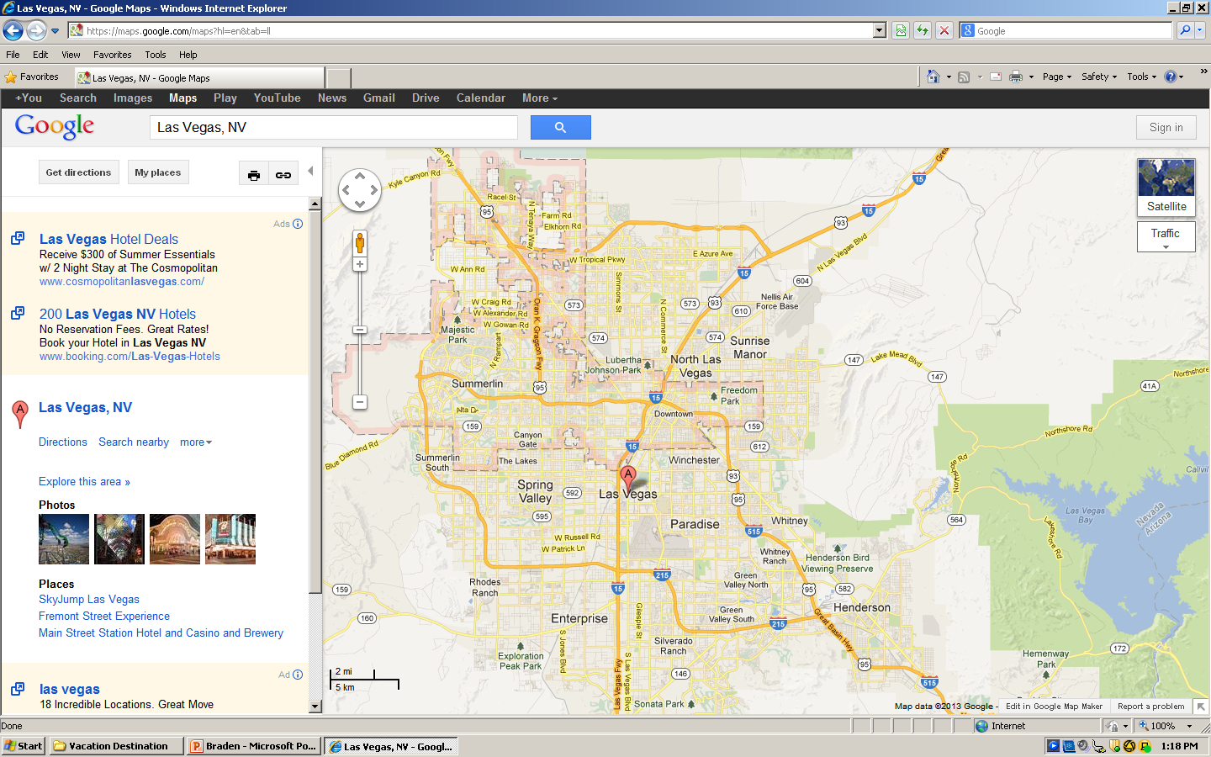
Map

Slide 3
Transportation
Transportation | Budget
Airfare | $259
Airfare Parking at Airport | $
Airline | $
Total | $
Figure out gas:
Find miles (google Maps)
Divide miles by 25
Take that number x gas price

Slide 4
Lodging
Lodging | Budget
Hotels $ x how many nights Not staying in the same place? Sunday Monday Tuesday Wednesday Thursday Friday Saturday | $0.00
Other | $0.00
Total | $0.00

Slide 5
Extra Expense
Extra expenses | Budget
Souvenirs ($0.00 x # of people) x # of purchases | $0.00
Snacks ($0.00 x # of people) x # of purchases | $0.00
Emergency cash | $0.00
Total | $0.00

Slide 6
Itinerary
Total Expense: $0.00
Saturday, June 8th | Where | How Much?
Breakfast | The Henry - The Cosmopolitan of Las Vegas
Activity | Royal Links Golf Club
Lunch | Spice Market Buffet
Activity | Wynn Las Vegas
Dinner | Yun Nan Garden
Activity | Las Vegas casino

Slide 7
Itinerary
Total Expense: $0.00
Sunday, June 9th | Where | How Much?
Breakfast | Grand Lux Cafe | $0.00
Activity |  | $0.00
Lunch |  | $0.00
Activity | Desert Pines Golf Club | $0.00
Dinner | Social House | $50
Activity |  | $

Slide 8
Itinerary
Total Expense: $0.00
Monday, June 10th | Where | How Much?
Breakfast |  | $0.00
Activity | Eiffel Tower Experience at Paris Las Vegas | $0.00
Lunch |  | $0.00
Activity | Desert Pines Golf Club | $0.00
Dinner |  | $0.00
Activity |  | $0.00

Slide 9
Itinerary
Total Expense: $0.00
Tuesday, June 11th | Where | How Much?
Breakfast |  | $0.00
Activity |  | $0.00
Lunch |  | $0.00
Activity |  | $0.00
Dinner |  | $0.00
Activity |  | $0.00

Slide 10
Itinerary
Total Expense: $0.00
Wednesday, June 12th | Where | How Much?
Breakfast |  | $0.00
Activity |  | $0.00
Lunch |  | $0.00
Activity |  | $0.00
Dinner |  | $0.00
Activity |  | $0.00

Slide 11
Itinerary
Total Expense: $0.00
Thursday, June 13th | Where | How Much?
Breakfast |  | $0.00
Activity |  | $0.00
Lunch |  | $0.00
Activity |  | $0.00
Dinner |  | $0.00
Activity |  | $0.00

Slide 12
Itinerary
Total Expense: $0.00
Friday, June 14th | Where | How Much?
Breakfast |  | $0.00
Activity |  | $0.00
Lunch |  | $0.00
Activity |  | $0.00
Dinner |  | $0.00
Activity |  | $0.00

Slide 13
Itinerary
Total Expense: $0.00
Saturday, June 15th | Where | How Much?
Breakfast |  | $0.00
Activity |  | $0.00
Lunch |  | $0.00
Activity |  | $0.00
Dinner |  | $0.00
Activity |  | $0.00

