Slide 1
Sevierville TN 1,582
Traveling June 8-15 2013
Planned By:
Caleb Cruz

Slide 2
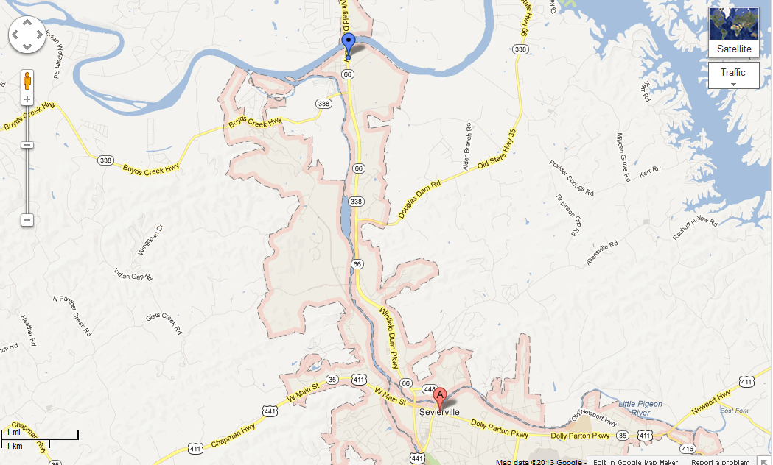
Map

Slide 3
Transportation
Transportation | Budget
Airfare x (family) | $0.00
Airfare Parking at Airport | $0.00
Car Rental | $0.00
Gas (going) [price x 25/ MPG] | $0.00
Gas (coming home) [price x 25/ MPG] | $0.00
Bus Tickets | $0.00
Train | $0.00
Other | $0.00
Total | $0.00
Figure out gas:
Find miles 252
Divide miles by 25=20.16
Take that number x gas price

Slide 4
Lodging
Lodging | Budget
Hotels $ x how many nights The Resort at Governor's Crossing142x6 Not staying in the same place? Sunday Monday Tuesday Wednesday Thursday Friday Saturday | $852.00
Other | $852.00
Total | $852.00

Slide 5
Extra Expense
Extra expenses | Budget
Souvenirs ($15.00 x4 of people) x 3 of purchases | 180.00
Snacks ($3.00 x 4of people) x 5of purchases | $60.00
Emergency cash | $150.00
Total | $390.00

Slide 6
Itinerary
Total Expense: $80.00
Saturday, June 8th | Where | How Much?
Breakfast | Home | $0.00
Activity | driving | $0.00
Lunch | Chick fla 7.00x 4 | $28.00
Activity | Driving | $0.00
Dinner | Hotel 13.00 x 4 | $52.00
Activity | Watch tv | $0.00

Slide 7
Itinerary
Total Expense: $148.00
Sunday, June 9th | Where | How Much?
Breakfast | McDonalds 7x4 | $28.00
Activity | Aquarium 2x 25 2x 13 | $76.00
Lunch | Hotel | $0.00
Activity | Hunted house 14.00x2 8.00x2 | $44.00
Dinner | Hotel | $0.00
Activity | Swimming | $0.00

Slide 8
Itinerary
Total Expense: $0.00
Monday, June 10th | Where | How Much?
Breakfast | Hotel | $0.00
Activity | Hotel | $0.00
Lunch | Hotel | $0.00
Activity | Hotel | $0.00
Dinner | Hotel | $0.00
Activity | Hotel | $0.00

Slide 9
Itinerary
Total Expense: $0.00
Tuesday, June 11th | Where | How Much?
Breakfast | Hotel | $0.00
Activity | Belie it or not 15.00x2 8.00x2 | 46.00
Lunch | McDonalds 7x4 | $28.00
Activity | World records | $0.00
Dinner | Thirsty miner 14x4 | $56.00
Activity | Swimming | $0.00

Slide 10
Itinerary
Total Expense: $112.00
Wednesday, June 12th | Where | How Much?
Breakfast | hotel | $0.00
Activity | Swimming | $0.00
Lunch | Big daddy's pizza 14x4 | $56.00
Activity | Swimming | $0.00
Dinner | Thirsty miner 14x4 | $56.00
Activity | Arcade | $0.00

Slide 11
Itinerary
Total Expense: $0.00
Thursday, June 13th | Where | How Much?
Breakfast | Sleep | $0.00
Activity | Sleep | $0.00
Lunch | Sleep | $0.00
Activity | Sleep | $0.00
Dinner | Sleep | $0.00
Activity | Sleep | $0.00

Slide 12
Itinerary
Total Expense: $0.00
Friday, June 14th | Where | How Much?
Breakfast | Hotel | $0.00
Activity | Hotel | $0.00
Lunch | Hotel | $0.00
Activity | Hotel | $0.00
Dinner | Hotel | $0.00
Activity | Hotel | $0.00

Slide 13
Itinerary
Total Expense: $0.00
Saturday, June 15th | Where | How Much?
Breakfast | Hotel | $0.00
Activity | Hotel | $0.00
Lunch | Hotel | $0.00
Activity | Hotel | $0.00
Dinner | Hotel | $0.00
Activity | Hotel | $0.00

