Slide 1
Athens, Greece
Traveling June 8-15 2013
Planned By:
Chris Scalzi

Slide 2
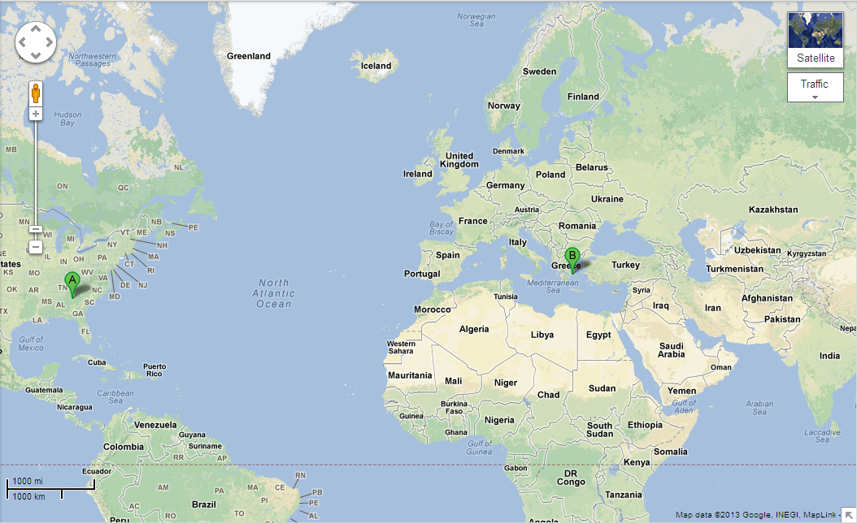
Map

Slide 3
Transportation
Transportation | Budget
Airfare 1,560 x (4) | $6,240.00
Airfare Parking at Airport | $50.00
Car Rental | $151.00
Gas (going) [price x 25/ MPG] | $100.00
Gas (coming home) [price x 25/ MPG] | $0.00
Bus Tickets | $0.00
Train | $0.00
Other | $0.00
Total | $6,541.00
Figure out gas:
Find miles (google Maps)
Divide miles by 25
Take that number x gas price

Slide 4
Lodging
Lodging | Budget
Hotels $ x how many nights Hotel Grande Bretagne Athens $311.00x6 Not staying in the same place? Sunday Monday Tuesday Wednesday Thursday Friday Saturday | $1,866.00
Other | $0.00
Total | $1,866.00

Slide 5
Extra Expense
Extra expenses | Budget
Souvenirs ($50.00 x4 of people)x6 of purchases | $1,200.00
Snacks ($10.00 x 4of people) x2 of purchases | $80.00
Emergency cash | $100.00
Total | $1,380.00

Slide 6
Itinerary
Total Expense: $320.00
Saturday, June 8th | Where | How Much?
Breakfast | Oroscopo $20.00 x 4 | $80.00
Activity | Sight Seeing | $0.00
Lunch | Oroscopo $20.00 x 4 | $80.00
Activity | Athens Zoo $20.00 x 4 | $80.00
Dinner | Oroscopo $20.00 x 4 | $80.00
Activity |  | $0.00

Slide 7
Itinerary
Total Expense: $0.00
Sunday, June 9th | Where | How Much?
Breakfast | Oroscopo$20.00X4 | $80.00
Activity | Parthenon (Parthenonas) | $0.00
Lunch | Oroscopo$20.00X4 | $80.00
Activity | The Acropolis Museum | $0.00
Dinner | Oroscopo$20.00X4 | $80.00
Activity |  | $0.00

Slide 8
Itinerary
Total Expense: $0.00
Monday, June 10th | Where | How Much?
Breakfast | Oroscopo$20.00x4 | $80.00
Activity | National Archaeological Museum | $0.00
Lunch | Oroscopo$20.00X4 | $80.00
Activity |  | $0.00
Dinner | Oroscopo$20.00X4 | $80.00
Activity |  | $0.00

Slide 9
Itinerary
Total Expense: $0.00
Tuesday, June 11th | Where | How Much?
Breakfast | Oroscopo$20.00X4 | $80.00
Activity |  | $0.00
Lunch | Oroscopo$20.00X4 | $80.00
Activity |  | $0.00
Dinner | Oroscopo$20.00X4 | $80.00
Activity |  | $0.00

Slide 10
Itinerary
Total Expense: $0.00
Wednesday, June 12th | Where | How Much?
Breakfast | Oroscopo$20.00X4 | $80.00
Activity |  | $0.00
Lunch | Oroscopo$20.00X4 | $80.00
Activity |  | $0.00
Dinner | Oroscopo$20.00X4 | $80.00
Activity |  | $0.00

Slide 11
Itinerary
Total Expense: $0.00
Thursday, June 13th | Where | How Much?
Breakfast | Oroscopo$20.00X4 | $80.00
Activity |  | $0.00
Lunch | Oroscopo$20.00X4 | $80.00
Activity |  | $0.00
Dinner | Oroscopo$20.00X4 | $80.00
Activity |  | $0.00

Slide 12
Itinerary
Total Expense: $0.00
Friday, June 14th | Where | How Much?
Breakfast | Oroscopo$20.00X4 | $80.00
Activity |  | $0.00
Lunch | Oroscopo$20.00X4 | $80.00
Activity |  | $0.00
Dinner | Oroscopo$20.00X4 | $80.00
Activity |  | $0.00

Slide 13
Itinerary
Total Expense: $0.00
Saturday, June 15th | Where | How Much?
Breakfast | Oroscopo$20.00X4 | $80.00
Activity |  | $0.00
Lunch | Oroscopo$20.00X4 | $80.00
Activity |  | $0.00
Dinner | Oroscopo$20.00X4 | $80.00
Activity |  | $0.00

