Slide 1
Paris, France
Traveling June 8-15 2013
Planned By:
Cristina Samuel

Slide 2
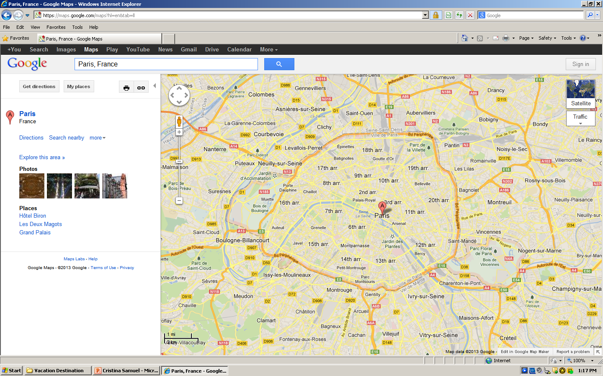
Map

Slide 3
Transportation
Transportation | Budget
Airfare x (family) $1653.00 x 4 | $6572.00
Airfare Parking at Airport | $30.00
Car Rental | $0.00
Gas (going) [price x 25/ MPG] | $0.00
Gas (coming home) [price x 25/ MPG] | $0.00
Bus Tickets | $0.00
Train | $0.00
Other | $0.00
Total | $6602.00
Figure out gas:
Find miles (google Maps)
Divide miles by 25
Take that number x gas price

Slide 4
Lodging
Lodging | Budget
Hotels $ x how many nights Paris Marriott Rive Gauche Hotel Conference Center Not staying in the same place? Sunday Monday Tuesday Wednesday Thursday Friday Saturday | $3372.00
Other | $0.00
Total | $3372.00

Slide 5
Extra Expense
Extra expenses | Budget
Souvenirs ($10.00 x 4 of people) x 3 of purchases | $120.00
Snacks ($5.00 x 4 of people) x 7 of purchases | $140.00
Emergency cash | $100.00
Total | $360.00

Slide 6
Itinerary
Total Expense: $0.00
Saturday, June 8th | Where | How Much?
Breakfast | Kashmir House . | $0.00
Activity | Hang out with friends | $0.00
Lunch | Sagar Matha . | $0.00
Activity | Swim | $0.00
Dinner | Le Palais de Raja Maharaja . | $0.00
Activity | Watch T.V. | $0.00

Slide 7
Itinerary
Total Expense: $0.00
Sunday, June 9th | Where | How Much?
Breakfast | Bistrotters . | $0.00
Activity | Swim | $0.00
Lunch | Mistral | $0.00
Activity | Hang out with friends | $0.00
Dinner | L'estrapade . $45.00 x 4 | $180.00
Activity | Watch a movie on T.V. | $0.00

Slide 8
Itinerary
Total Expense: $0.00
Monday, June 10th | Where | How Much?
Breakfast | Le Cinq . | $0.00
Activity | Take a walk | $0.00
Lunch | La Veraison . | $0.00
Activity | Swim | $0.00
Dinner | Epicure . | $0.00
Activity | Watch T.V. | $0.00

Slide 9
Itinerary
Total Expense: $0.00
Tuesday, June 11th | Where | How Much?
Breakfast |  | $0.00
Activity |  | $0.00
Lunch |  | $0.00
Activity |  | $0.00
Dinner |  | $0.00
Activity |  | $0.00

Slide 10
Itinerary
Total Expense: $0.00
Wednesday, June 12th | Where | How Much?
Breakfast |  | $0.00
Activity |  | $0.00
Lunch |  | $0.00
Activity |  | $0.00
Dinner |  | $0.00
Activity |  | $0.00

Slide 11
Itinerary
Total Expense: $0.00
Thursday, June 13th | Where | How Much?
Breakfast |  | $0.00
Activity |  | $0.00
Lunch |  | $0.00
Activity |  | $0.00
Dinner |  | $0.00
Activity |  | $0.00

Slide 12
Itinerary
Total Expense: $0.00
Friday, June 14th | Where | How Much?
Breakfast |  | $0.00
Activity |  | $0.00
Lunch |  | $0.00
Activity |  | $0.00
Dinner |  | $0.00
Activity |  | $0.00

Slide 13
Itinerary
Total Expense: $0.00
Saturday, June 15th | Where | How Much?
Breakfast |  | $0.00
Activity |  | $0.00
Lunch |  | $0.00
Activity |  | $0.00
Dinner |  | $0.00
Activity |  | $0.00

