Slide 1
New York City, New York
Traveling June 8-15 2013
Planned By:
Erin Cleetus

Slide 2
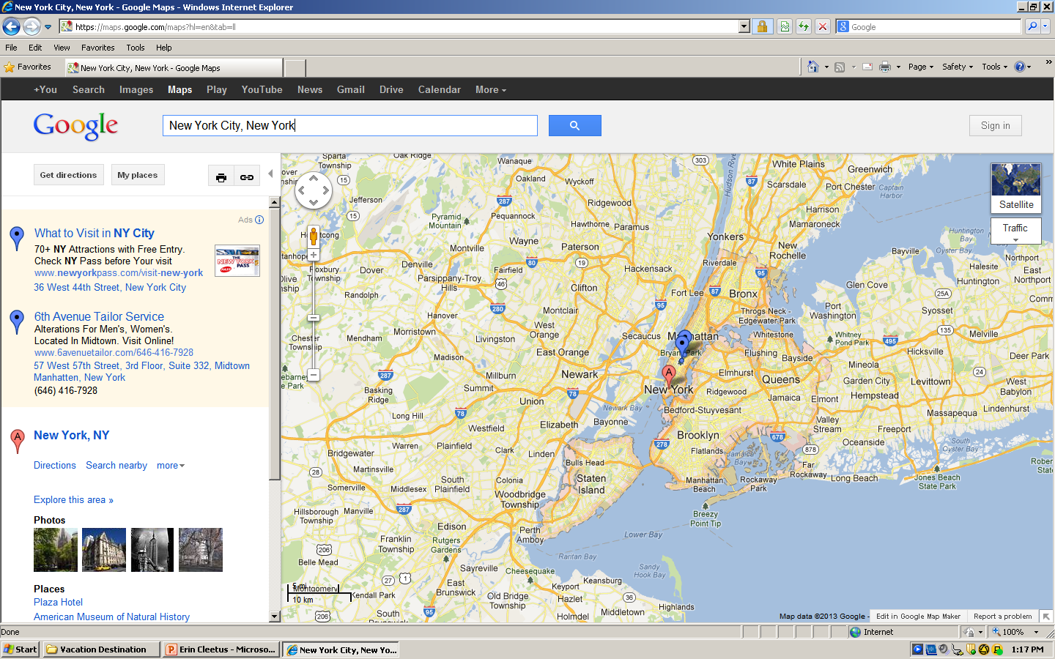
Map

Slide 3
Transportation
Transportation | Budget
Airfare x (family) 218 x 5 = | $1,090.00
Airfare Parking at Airport | $0.00
Car Rental | $0.00
Gas (going) [price x 25/ MPG] | $0.00
Gas (coming home) [price x 25/ MPG] | $0.00
Bus Tickets | $0.00
Train | $0.00
Other | $0.00
Total | $0.00
Figure out gas:
Find miles (google Maps)
Divide miles by 25
Take that number x gas price

Slide 4
Lodging
Lodging | Budget
Hotels $ x how many nights ONE UN New York 470 multiply by 6 = $2,820 Not staying in the same place? Sunday Monday Tuesday Wednesday Thursday Friday Saturday | $2,820
Other | $0.00
Total | $2,820

Slide 5
Extra Expense
Extra expenses | Budget
Souvenirs ($15.00 x 5) x 3 of purchases | $225.00
Snacks ($5.00 x 5 ) x 3 of purchases | $75.00
Emergency cash | $110.00
Total | $410.00

Slide 6
Itinerary
Total Expense: $170.00
Saturday, June 8th | Where | How Much?
Breakfast | home | $0.00
Activity | Walk around central park | $0.00
Lunch | Vanessa's dumplings 13 x 5 = | $65.00
Activity | Central park zoo 16 x 3 11 x 2 | $70.00
Dinner | McDonald's 7 x 5 =35 | $35.00
Activity | Hotel pool | $0.00

Slide 7
Itinerary
Total Expense: $0.00
Sunday, June 9th | Where | How Much?
Breakfast | Cranberry deli 5 x 5 | $25.00
Activity | Battery Park | $0.00
Lunch | Friends house | $0.00
Activity | Deon's Wonder Wheel Park 45 x 5 | $225.00
Dinner |  | $0.00
Activity | Stay home and play with my brother | $0.00

Slide 8
Itinerary
Total Expense: $0.00
Monday, June 10th | Where | How Much?
Breakfast | home | $0.00
Activity | Staten island ferry | $447.00
Lunch |  | $0.00
Activity | Manhattan Skyline helicopter tour 149 x 3 | $447.00
Dinner | home | $0.00
Activity | Call friends | $0.00

Slide 9
Itinerary
Total Expense: $190.00
Tuesday, June 11th | Where | How Much?
Breakfast | Mc donald’s | $10.00
Activity | Walk around | $0.00
Lunch | Gramercy Tavern 15 x 5 | $75.00
Activity | Jersey Boys 21 x 5 | $105.00
Dinner | home | $0.00
Activity | Swimming pool | $0.00

Slide 10
Itinerary
Total Expense: $0.00
Wednesday, June 12th | Where | How Much?
Breakfast |  | $0.00
Activity |  | $0.00
Lunch |  | $0.00
Activity |  | $0.00
Dinner |  | $0.00
Activity |  | $0.00

Slide 11
Itinerary
Total Expense: $0.00
Thursday, June 13th | Where | How Much?
Breakfast |  | $0.00
Activity |  | $0.00
Lunch |  | $0.00
Activity |  | $0.00
Dinner |  | $0.00
Activity |  | $0.00

Slide 12
Itinerary
Total Expense: $0.00
Friday, June 14th | Where | How Much?
Breakfast |  | $0.00
Activity |  | $0.00
Lunch |  | $0.00
Activity |  | $0.00
Dinner |  | $0.00
Activity |  | $0.00

Slide 13
Itinerary
Total Expense: $0.00
Saturday, June 15th | Where | How Much?
Breakfast | home | $0.00
Activity | Stay home | $0.00
Lunch | home | $0.00
Activity | Ground Zero Museum Workshop | $50.00
Dinner | home | $0.00
Activity | Pack up to leave | $0.00

