Slide 1
The Bahamas
Traveling June 8-15 2013
Planned By:
Jake Herren

Slide 2
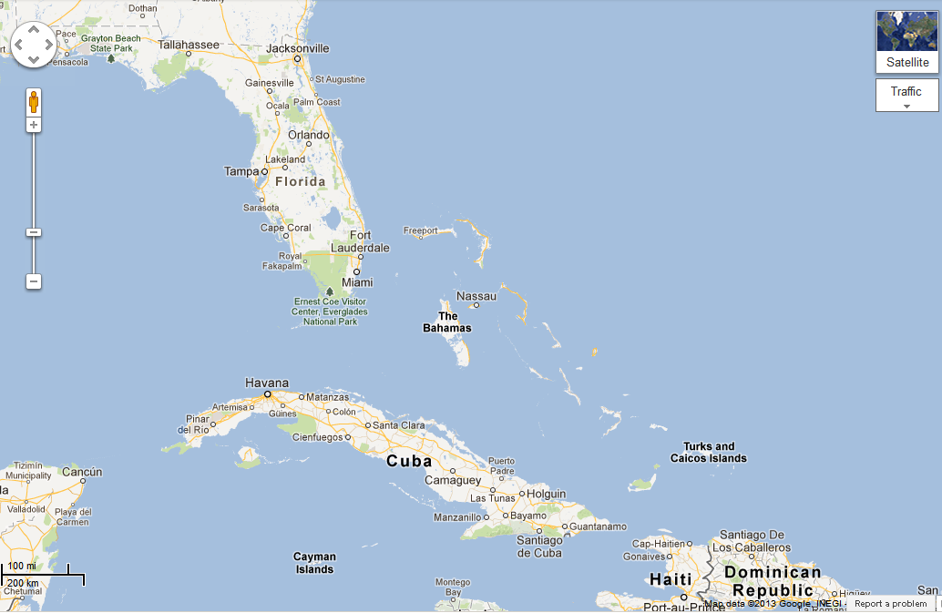
Map

Slide 3
Transportation
Transportation | Budget
Airfare x (family) 649*4 | $2596.00
Airfare Parking at Airport | $50.00
Car Rental | $0.00
Gas (going) [price x 25/ MPG] | $0.00
Gas (coming home) [price x 25/ MPG] | $0.00
Bus Tickets | $0.00
Train | $0.00
Other | $0.00
Total | $2646.00
Figure out gas:
Find miles (google Maps)
Divide miles by 25
Take that number x gas price

Slide 4
Lodging
Lodging | Budget
Hotels $ x how many nights Grand Isle Resort And Spa 350*6 Not staying in the same place? Sunday Monday Tuesday Wednesday Thursday Friday Saturday | $2100.00
Other | $0.00
Total | $2100.00

Slide 5
Extra Expense
Extra expenses | Budget
Souvenirs ($20.00 x 4 of people) x 4 of purchases | $320.00
Snacks ($5.00 x #4 of people) x 7of purchases | $140.00
Emergency cash | $100.00
Passport 2x165=330 120*2=240 | $570.00
Total | $1,130

Slide 6
Itinerary
Total Expense: $132.00
Saturday, June 8th | Where | How Much?
Breakfast | Mcdonalds 7*4=28 | $28.00
Activity | Go to the beach | $0.00
Lunch | Latitudes at Exuma Beach Resort 13*4=52 | $52.00
Activity | Stay at the hotel and watch television | $0.00
Dinner | Houseman On The Bay Bar & Restaurant 13*4=52 | $52.00
Activity | Hotel pool | $0.00

Slide 7
Itinerary
Total Expense: $96.00
Sunday, June 9th | Where | How Much?
Breakfast | Hotel | $0.00
Activity | Go to the amusment park 10*4=40 | $40.00
Lunch | Burger King 7*4=28 | $28.00
Activity | Hotel Pool | $0.00
Dinner | Driftwood Café 7*4=28 | $28.00
Activity | Hotel relaxing | $0.00

Slide 8
Itinerary
Total Expense: $835.00
Monday, June 10th | Where | How Much?
Breakfast | Hotel | $0.00
Activity | Go on a crews 200*4=800 | $800.00
Lunch | Wendy’s | $7.00
Activity | Relax at the hotel and sleep | $0.00
Dinner | Chick-Fil-A 7*4=28 | $28.00
Activity | Hotel pool | $0.00

Slide 9
Itinerary
Total Expense: $68.00
Tuesday, June 11th | Where | How Much?
Breakfast | Hotel breakfast | $0.00
Activity | Go to the beach | $0.00
Lunch | Applebees 7*4=28 | $28.00
Activity | Go to the pool | $0.00
Dinner | O’charleys 10*4=40 | $40.00
Activity | Relax and watch television and fall asleep | $0.00

Slide 10
Itinerary
Total Expense: $56.00
Wednesday, June 12th | Where | How Much?
Breakfast | Hotel breakfast | $0.00
Activity | Relax at the hotel | $0.00
Lunch | Mcdonalds 7*4=28 | $28.00
Activity | Hotel relaxation | $0.00
Dinner | Wendy’s 7*4=28 | $28.00
Activity | Hotel pool | $0.00

Slide 11
Itinerary
Total Expense: $148.00
Thursday, June 13th | Where | How Much?
Breakfast | Room Service | $0.00
Activity | Surfing | $0.00
Lunch | Burger King 7*4=28 | $0.00
Activity | Ziplining 30*4=120 | $120.00
Dinner | Mcdonalds 7*4=28 | $28.00
Activity | Relax | $0.00

Slide 12
Itinerary
Total Expense: $56.00
Friday, June 14th | Where | How Much?
Breakfast | Hotel Breakfast | $0.00
Activity | SLEEP | $0.00
Lunch | Wendy’s 7*4=28 | $28.00
Activity | Go to the beach | $0.00
Dinner | Applebees 7*4=28 | $28.00
Activity | sleep | $0.00

Slide 13
Itinerary
Total Expense: $56.00
Saturday, June 15th | Where | How Much?
Breakfast | Hotel Breakfast | $0.00
Activity | Packing Up | $0.00
Lunch | Mcdonalds 7x4=28 | $28.00
Activity | Leaving | $0.00
Dinner | Wendy’s 7x4=28 | $28.00
Activity | SLEEP | $0.00

