Slide 1
Beijing, China
Traveling June 8-15 2013
Planned By:
Jennifer Guo
Total cost:
$196,168.00

Slide 2
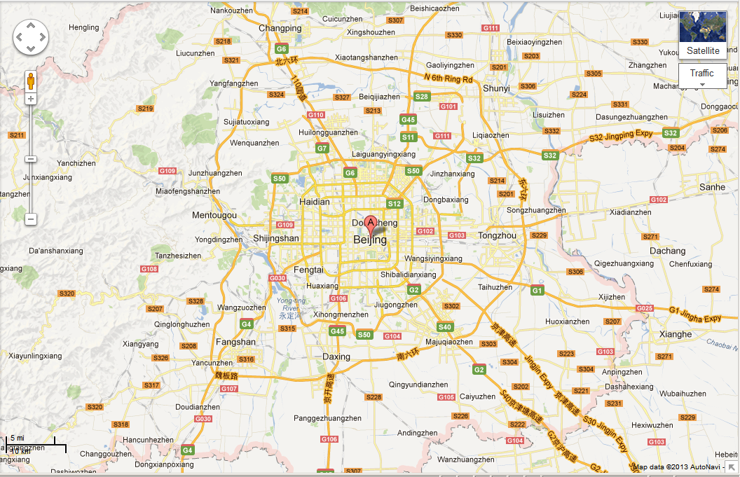
Map

Slide 3
Transportation
Transportation | Budget
Airfare =$13,404 (4 people going) | $13,404.00
Airfare Parking at Airport | $0.00
Car Rental | $0.00
Gas (going) [price x 25/ MPG] | $0.00
Gas (coming home) [price x 25/ MPG] | $0.00
Bus Tickets | $0.00
Train | $0.00
Other | $0.00
Total | $26,808.00
Figure out gas:
Find miles (google Maps)
Divide miles by 25
Take that number x gas price

Slide 4
Lodging
Lodging | Budget
Hotels $126.00 x 6 nights Beijing: Dong Cheng - Wangfujing Street, Beijing, CN Not staying in the same place? Sunday Monday Tuesday Wednesday Thursday Friday Saturday | $0.00
Other | $0.00
Total | $756.00

Slide 5
Extra Expense
Extra expenses | Budget
Souvenirs ($15.00 x 4 of people) x 3 of purchases | $180.00
Snacks ($0.00 x # of people) x # of purchases | $0.00
Emergency cash | $300.00
Total | $480.00

Slide 6
Itinerary
Total Expense: $0.00
Saturday, June 8th | Where | How Much?
Breakfast | Home sweet home | $0.00
Activity | Fly | $0.00
Lunch | Airplane food | $0.00
Activity | Fly | $0.00
Dinner | Airplane food | $0.00
Activity | Fly/sleep | $0.00

Slide 7
Itinerary
Total Expense: $52.00
Sunday, June 9th | Where | How Much?
Breakfast | Wangfujing | $0.00
Activity | Shop | $10.00
Lunch | Haidilao(13x4) | $52.00
Activity | Continue to shop | $10.00
Dinner | Wangfujing | $0.00
Activity | sleep | $0.00

Slide 8
Itinerary
Total Expense: $52.00
Monday, June 10th | Where | How Much?
Breakfast | Wangfujing | $0.00
Activity | Visit Great Wall of China | $0.00
Lunch | Haidilao(13x4) | $52.00
Activity | Visit Great Wall of China | $0.00
Dinner | Wangfujing | $0.00
Activity | sleep | $0.00

Slide 9
Itinerary
Total Expense: $052.00
Tuesday, June 11th | Where | How Much?
Breakfast | Wangfujing | $0.00
Activity | Summer Palace#2 | $0.00
Lunch | Haidilao(13x4) | $52.00
Activity | Summer Palace#2 | $0.00
Dinner | Wangfujing | $0.00
Activity | sleep | $0.00

Slide 10
Itinerary
Total Expense: $052.00
Wednesday, June 12th | Where | How Much?
Breakfast | Wangfujing | $0.00
Activity | Jingshan Park#4 | $0.00
Lunch | Haidilao(13x4) | $52.00
Activity | Jingshan Park#4 | $0.00
Dinner | Wangfujing | $0.00
Activity | sleep | $0.00

Slide 11
Itinerary
Total Expense: $52.00
Thursday, June 13th | Where | How Much?
Breakfast | Wangfujing | $0.00
Activity | Temple of Heaven#7 | $0.00
Lunch | Haidilao(13x4) | $52.00
Activity | Temple of Heaven#7 | $0.00
Dinner | Wangfujing | $0.00
Activity | sleep | $0.00

Slide 12
Itinerary
Total Expense: $52.00
Friday, June 14th | Where | How Much?
Breakfast | Wangfujing | $0.00
Activity | Beihai Park#6 | $0.00
Lunch | Haidilao(13x4) | $52.00
Activity | Beihai Park#6 | $0.00
Dinner | Wangfujing | $0.00
Activity | sleep | $0.00

Slide 13
Itinerary
Total Expense: $52.00
Saturday, June 15th | Where | How Much?
Breakfast | Wangfujing | $0.00
Activity | Black Lakes#23 | $0.00
Lunch | Haidilao(13x4) | $52.00
Activity | Black Lakes#23 | $0.00
Dinner | Wangfujing | $0.00
Activity | sleep | $0.00

