Slide 1
Helen G.A
Traveling June 8-15 2013
Planned By:
Jordyn Simmons

Slide 2
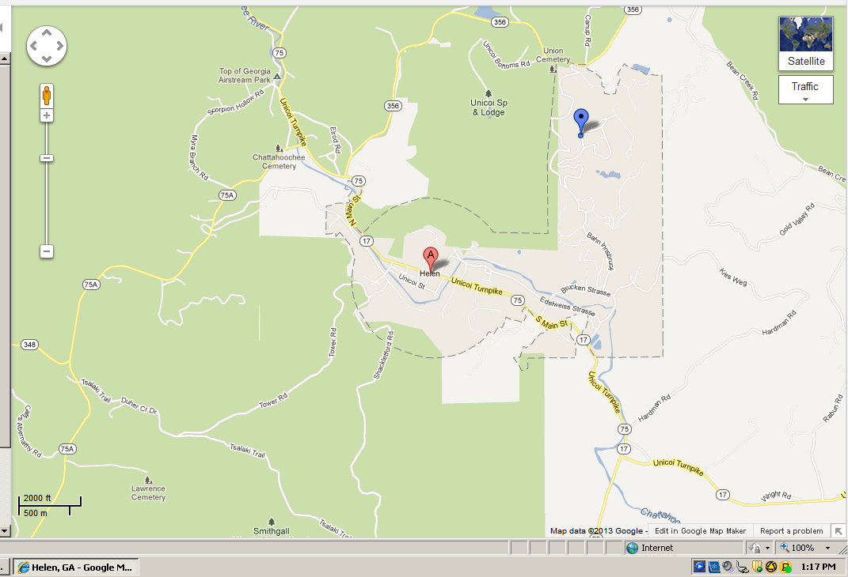
Map

Slide 3
Transportation
Transportation | Budget
Airfare x (family) | $0.00
Airfare Parking at Airport | $0.00
Car Rental | $170.99
Gas (going) [price x 25/ MPG] | $28.68
Gas (coming home) [price x 25/ MPG] | $29.99
Bus Tickets | $0.00
Train | $0.00
Other | $0.00
Total | $229.66
Figure out gas:
Find miles (google Maps)
Divide miles by 25
Take that number x gas price

Slide 4
Lodging
Lodging | Budget
Hotels $20.00 x 12 days show many nights Sunday Monday Tuesday Wednesday Thursday Friday Saturday | $204.00
Other | $0.00
Total | $204.00
Country Inn and Suites By Carlson Helen GA

Slide 5
Extra Expense
Extra expenses | Budget
Souvenirs ($15.00 x # of people) x # of purchases | $15.00
Snacks ($10.00 x 2 people) x 7 | $140.00
Emergency cash | $600.00
Total | $818.00

Slide 6
Itinerary
Total Expense: $174.00
Saturday, June 8th | Where | How Much?
Breakfast | in the hotel
Activity | put, put 2 x 12.00 | $24.00
Lunch | Huddle House 2 x 20.00 | $40.00
Activity | Go shopping 2 x 30.00 each | $60.00
Dinner | Hogpen Gap Grill 2 x 15.00 | $30.00
Activity | Go to the pool

Slide 7
Itinerary
Total Expense: $184.00
Sunday, June 9th | Where | How Much?
Breakfast | I Hop 2 x 15.00 | $30.00
Activity | Beach
Lunch | County Café 2 x 10.00 | $20.00
Activity | Zip lining 2 x 35.00 | $70.00
Dinner | Bodensee 2 x 20.00 | $40.00
Activity | Bakery 2 x 12.00 each | $24.00

Slide 8
Itinerary
Total Expense: $165.00
Monday, June 10th | Where | How Much?
Breakfast | I hop 2 x 15.00 | $30.00
Activity | Water Park 2 x 12.00 | $24.00
Lunch | County cafe 2 x 10.00 | $10.00
Activity | House back riding 2 x 65.00 | $130.00
Dinner | County cafe 2 x 10.00 | $40.00
Activity | pool

Slide 9
Itinerary
Total Expense: $114.00
Tuesday, June 11th | Where | How Much?
Breakfast | in the hotel
Activity | Rock claiming 2 x 25.00 | $50.00
Lunch | County cafe 2 x 10.00 | $20.00
Activity | put, put 2 x 12.00 | $24.00
Dinner | County cafe 2 x 10.00 | $20.00
Activity | pool

Slide 10
Itinerary
Total Expense: $164.00
Wednesday, June 12th | Where | How Much?
Breakfast | County cafe 2 x 10.00 | $0.00
Activity | Rock claiming 2 x 25.00 | $50.00
Lunch | County cafe 2 x 10.00 | $20.00
Activity | putt, putt 2 x 12.00 | $24.00
Dinner | County cafe 2 x 10.00 | $0.00
Activity | Movie 2 x 35.00 | $70.00

Slide 11
Itinerary
Total Expense: $70.00
Thursday, June 13th | Where | How Much?
Breakfast | in the hotel
Activity | pool
Lunch | in the hotel
Activity | pool
Dinner | in the hotel
Activity | Movie 2 x 35.00 | $70.00

Slide 12
Itinerary
Total Expense: $90.00
Friday, June 14th | Where | How Much?
Breakfast | County cafe 2 x 10.00 | $20.00
Activity | pool
Lunch | in the hotel
Activity | Rock claiming 2 x 25.00 | $50.00
Dinner | County cafe 2 x 10.00 | $20.00
Activity | pool

Slide 13
Itinerary
Total Expense: $74.00
Saturday, June 15th | Where | How Much?
Breakfast | in hotel
Activity | Rock claiming 2 x 25.00 | $50.00
Lunch | put, put 2 x 12.00 | $24.00
Activity | pool
Dinner | in hotel
Activity | pool

