Slide 1
Birmingham, Alabama $248.16
Traveling June 8-15 2013
Planned By:
Kaylee Tice

Slide 2
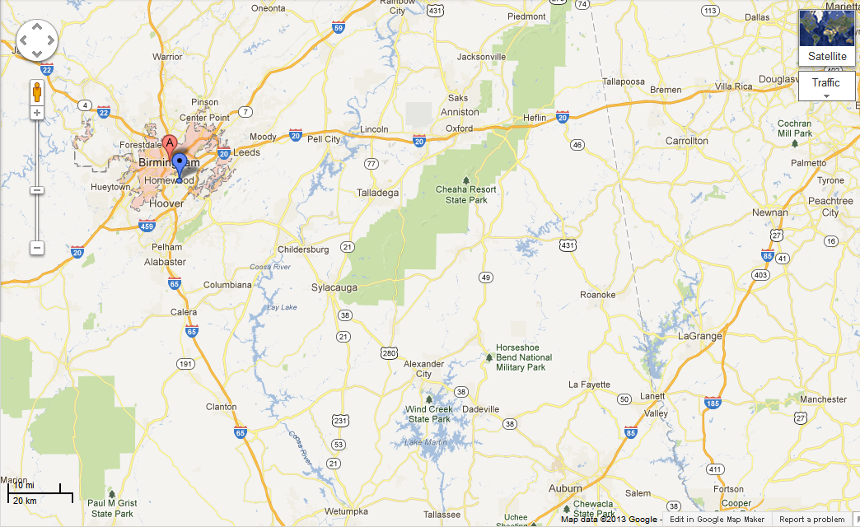
Map

Slide 3
Transportation
Transportation | Budget
Airfare x (family) | $0.00
Airfare Parking at Airport | $0.00
Car Rental | $0.00
Gas (going) [price x 25/ MPG] | $7.16
Gas (coming home) [price x 25/ MPG] | $7.16
Bus Tickets | $0.00
Train | $0.00
Other | $0.00
Total | $0.00
Figure out gas:
Find miles (google Maps)179
Divide miles by 25
Take that number x gas price

Slide 4
Lodging
Lodging | Budget
Hotels $ x how many nights Not staying in the same place? Sunday Monday Tuesday Wednesday Thursday Friday Saturday | $0.00
Other: Friend’s aunt’s house | $0.00
Total | $0.00

Slide 5
Extra Expense
Extra expenses | Budget
Souvenirs ($0.00 x # of people) x # of purchases | $0.00
Snacks ($4.00 x 2 of people) x 2 of purchases | $16.00
Emergency cash | $100.00
Total | $16.00

Slide 6
Itinerary
Total Expense: $50.00
Saturday, June 8th | Where | How Much?
Breakfast | At house Grocery Store | $150.00
Activity | Playing in lake | $0.00
Lunch | At house | $0.00
Activity | Boat ride | $0.00
Dinner | Golden Coral | $50.00
Activity | Played outside | $0.00

Slide 7
Itinerary
Total Expense: $28.00
Sunday, June 9th | Where | How Much?
Breakfast | At house | $0.00
Activity | Play at lake | $0.00
Lunch | Dairy Queen | $15.00
Activity | Play at the park | $0.00
Dinner | Wendy’s | $13.00
Activity | Go to water fall | $0.00

Slide 8
Itinerary
Total Expense: $0.00
Monday, June 10th | Where | How Much?
Breakfast | At house | $0.00
Activity | Playing in the lake | $0.00
Lunch | At an island | $0.00
Activity | Playing at island | $0.00
Dinner | At house | $0.00
Activity | Watching Disney channel | $0.00

Slide 9
Itinerary
Total Expense: $0.00
Tuesday, June 11th | Where | How Much?
Breakfast | At house | $0.00
Activity | Jumping into the lake | $0.00
Lunch | Ate at water fall | $0.00
Activity | Played at water fall | $0.00
Dinner | Ate at house | $0.00
Activity | Played with the 4 dogs | $0.00

Slide 10
Itinerary
Total Expense: $0.00
Wednesday, June 12th | Where | How Much?
Breakfast | Ate at house | $0.00
Activity | Played at lake | $0.00
Lunch | Ate on the speed boat | $0.00
Activity | Climbed water fall | $0.00
Dinner | Ate at house | $0.00
Activity | Played on the paddle boat | $0.00

Slide 11
Itinerary
Total Expense: $48.00
Thursday, June 13th | Where | How Much?
Breakfast | McDonalds | $7.00
Activity | Going to the mall | $20.00
Lunch | McDonalds | $21.00
Activity | Swam in the lake | $0.00
Dinner | Ate at house | $0.00
Activity | Watched TV | $0.00

Slide 12
Itinerary
Total Expense: $42.00
Friday, June 14th | Where | How Much?
Breakfast | Ate at house | $0.00
Activity | Swam in the lake | $0.00
Lunch | Wendy’s | $21.00
Activity | Went to see Martin Luther King jr’s house | $21.00
Dinner | Ate at house | $0.00
Activity | Played with the 4 dogs | $0.00

Slide 13
Itinerary
Total Expense: $57.00
Saturday, June 15th | Where | How Much?
Breakfast | McDonalds | $21.00
Activity | Drove in car | $0.00
Lunch | Burger King | $21.00
Activity | Rode on the train | $15.00
Dinner | ate left overs in the car | $0.00
Activity | Drove home | $0.00

