Slide 1
New York City
Planned By:
Lauren Shivers

Slide 2
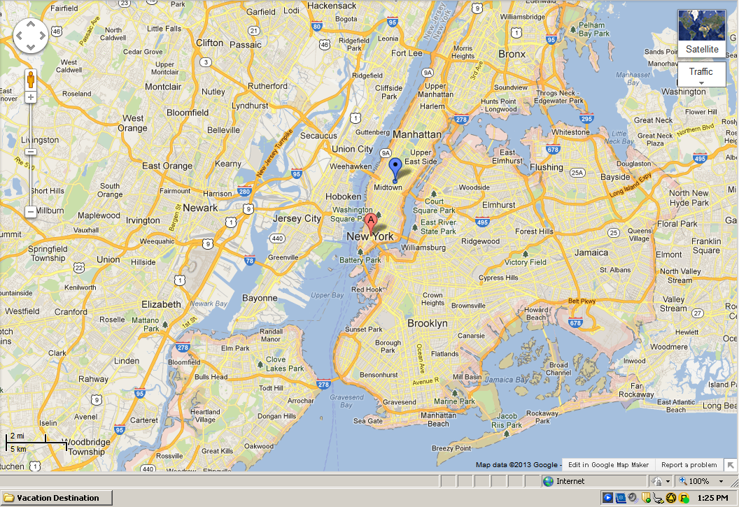
Map

Slide 3
Transportation
Transportation | Budget
Airfare x (family) | $0.00
Airfare Parking at Airport | $0.00
Car Rental | $0.00
Gas (going) [price x 25/ MPG] | $0.00
Gas (coming home) [price x 25/ MPG] | $0.00
Bus Tickets | $0.00
Train | $0.00
Other | $0.00
Total | $0.00
Figure out gas:
Find miles (google Maps)
Divide miles by 25
Take that number x gas price

Slide 4
Lodging
Lodging | Budget
Hotels $ x how many nights Not staying in the same place? Sunday Monday Tuesday Wednesday Thursday Friday Saturday | $0.00
Other | $0.00
Total | $0.00

Slide 5
Extra Expense
Extra expenses | Budget
Souvenirs ($30.00 x 4 of people) x*3 of purchases | $360.00
Snacks (5.00 * 4 of people) * 7 of purchases | $140.00
Emergency cash $100 x* 4 people | $400.00
Total | $900.00

Slide 6
Itinerary
Total Expense: $0.00
Saturday, June 8th | Where | How Much?
Breakfast | Pancakes at house | $0.00
Activity | driving | $0.00
 | Driving Gass 3.30 *1 | $3.30
Activity | driving | $0.00
Dinner | Hottell food 4*10 | $40.00
Activity | Watch tv | $0.00

Slide 8
Itinerary
Total Expense: $120.00
Sunday, June 9th | Where | How Much?
Breakfast | Hotell food 10.00*4 | $40.00
Activity | Explore with family | $0.00
Lunch | Hotell food 4*10.00 | $40.00
Activity | Walk the dog with dad and Christopher | $0.00
Dinner | hotell food | $40.00
Activity | Hotell relaxation | $0.00

Slide 9
Itinerary
Total Expense: 120.00
Monday, June 10th | Where | How Much?
Breakfast | Hotell food 4*10.00 | $40.00
Activity | Play at central park | $0.00
Lunch | Red Lobster 4 * 10.00 | $40.00
Activity | Walk the dog | $0.00
Dinner | Playwright Celtic pub 4 *10.00 | $40.00
Activity | Hotell relaxation | $0.00

Slide 10
Itinerary
Total Expense: $0.00
Tuesday, June 11th | Where | How Much?
Breakfast | Room service 4* 10.00 | $0.00
Activity | PLAY IN THE CENTRALL | $0.00
Lunch |  | $0.00
Activity |  | $0.00
Dinner |  | $0.00
Activity |  | $0.00

Slide 11
Itinerary
Total Expense: $0.00
Wednesday, June 12th | Where | How Much?
Breakfast |  | $0.00
Activity |  | $0.00
Lunch |  | $0.00
Activity |  | $0.00
Dinner |  | $0.00
Activity |  | $0.00

Slide 12
Itinerary
Total Expense: $0.00
Thursday, June 13th | Where | How Much?
Breakfast |  | $0.00
Activity |  | $0.00
Lunch |  | $0.00
Activity |  | $0.00
Dinner |  | $0.00
Activity |  | $0.00

Slide 13
Itinerary
Total Expense: $0.00
Friday, June 14th | Where | How Much?
Breakfast |  | $0.00
Activity |  | $0.00
Lunch |  | $0.00
Activity |  | $0.00
Dinner |  | $0.00
Activity |  | $0.00

Slide 14
Itinerary
Total Expense: $0.00
Saturday, June 15th | Where | How Much?
Breakfast |  | $0.00
Activity |  | $0.00
Lunch |  | $0.00
Activity |  | $0.00
Dinner |  | $0.00
Activity |  | $0.00

