Slide 1
Birmingham, Alabama
Traveling June 8-15 2013
Planned By:
Nick Kolb $1,160.50

Slide 2
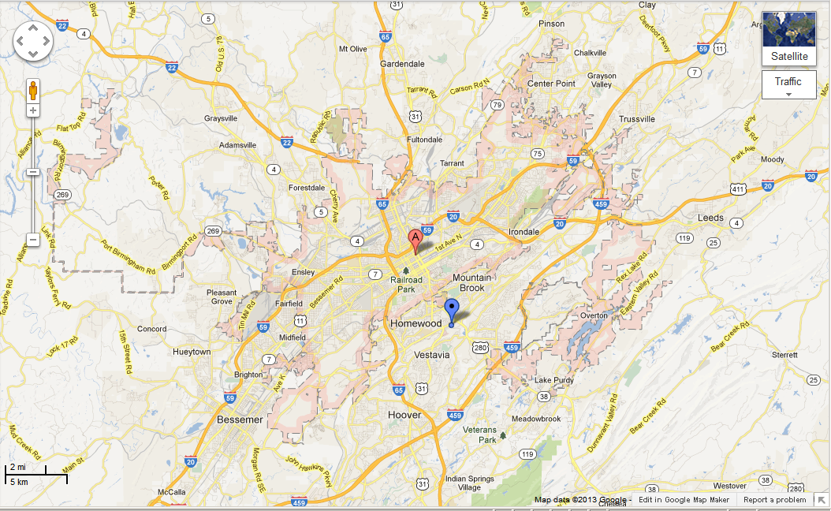
Map

Slide 3
Transportation
Transportation | Budget
Airfare x (family) | $0.00
Airfare Parking at Airport | $0.00
Car Rental | $0.00
Gas (going) [price x 25/ MPG] | $37.00
Gas (coming home) [price x 25/ MPG] | $45.00
Bus Tickets | $0.00
Train | $0.00
Other | $25.00
Total | $107.00
Figure out gas:
Find miles (google Maps)
Divide miles by 25
Take that number x gas price

Slide 4
Lodging
Lodging | Budget
Hotels $ x how many nights Not staying in the same place? Sunday Monday Tuesday Wednesday Thursday Friday Saturday | $0.00
Other Diane’s House | $0.00
Total | $0.00

Slide 5
Extra Expense
Extra expenses | Budget
Souvenirs ($20.00 x 5of people) x 2of purchases | $201.01
Snacks ($5.00 x 5of people) x 3of purchases | $75.01
Emergency cash | $701.52
Total | $977.54

Slide 6
Itinerary
Total Expense: $35.50
Saturday, June 8th | Where | How Much?
Breakfast | Diane’s | $0.00
Activity | Pawn shop | $35.50
Lunch | Diane’s | $0.00
Activity | Sherel’s fishing | $0.00
Dinner | Diane’s | $0.00
Activity | Be LAZY | $0.00

Slide 7
Itinerary
Total Expense: $10.00
Sunday, June 9th | Where | How Much?
Breakfast | Diane’s | $0.00
Activity | Levart’s shoot | $0.00
Lunch | Sherel’s | $0.00
Activity | Pawn shop | $10.00
Dinner | Waffle House | $0.00
Activity | Pool | $0.00

Slide 8
Itinerary
Total Expense: $0.00
Monday, June 10th | Where | How Much?
Breakfast | Diane’s | $0.00
Activity | Pool | $0.00
Lunch | Diane’s | $0.00
Activity | pool | $0.00
Dinner | Pizza | $0.00
Activity | t.v. | $0.00

Slide 9
Itinerary
Total Expense: $25.00
Tuesday, June 11th | Where | How Much?
Breakfast | Waffle house | $25.00
Activity | Fish | $0.00
Lunch | Dian’s | $0.00
Activity | pool | $0.00
Dinner | nothing | $0.00
Activity | sleep | $0.00

Slide 10
Itinerary
Total Expense:5.00
Wednesday, June 12th | Where | How Much?
Breakfast | Pizza | $5.00
Activity | shoot | $0.00
Lunch | Dian’s | $0.00
Activity | fish | $0.00
Dinner | Dian’s | $0.00
Activity | pool | $0.00

Slide 11
Itinerary
Total Expense: $0.00
Thursday, June 13th | Where | How Much?
Breakfast | Sherles | $0.00
Activity | fish | $0.00
Lunch | Dylan’s | $0.00
Activity | shoot | $0.00
Dinner | Dian’s | $0.00
Activity | Nothing | $0.00

Slide 12
Itinerary
Total Expense: $0.00
Friday, June 14th | Where | How Much?
Breakfast | Dian’s | $0.00
Activity | Fish | $0.00
Lunch | Pizza | $0.00
Activity | Shoot | $0.00
Dinner | Dylan’s | $0.00
Activity | pool | $0.00

Slide 13
Itinerary
Total Expense: $10.00
Saturday, June 15th | Where | How Much?
Breakfast | Dian’s | $0.00
Activity | fish | $0.00
Lunch | Waffle house | $10.00
Activity | Shoot | $0.00
Dinner | Pizza | $0.00
Activity | Pool | $0.00

