Slide 1
Paris, France
Traveling June 8-15 2013
Planned By:
Nooree Husnani

Slide 2
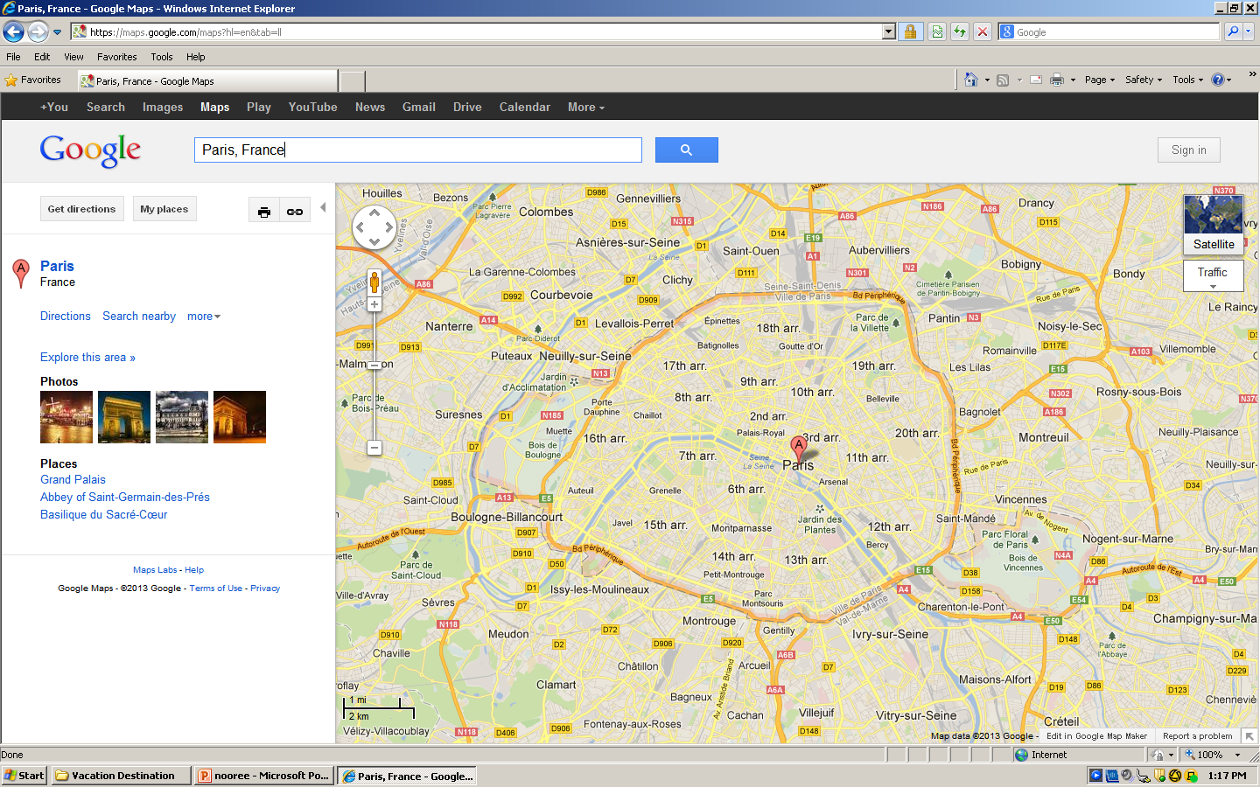
Map

Slide 3
Transportation
Transportation | Budget
Airfare 1,625x (2) | $3,250.00
Airfare Parking at Airport | $30.00
Car Rental | $100.00
Gas (going) [price x 25/ MPG] | $0.00
Gas (coming home) [price x 25/ MPG] | $0.00
Bus Tickets | $10.00
Train | $0.00
Other | $30.00
Total | $3,240.00
Figure out gas:
Find miles (google Maps)
Divide miles by 25
Take that number x gas price

Slide 4
Lodging
Lodging | Budget
173x 6 Quality Hotel Paris Orleans Not staying in the same place? Sunday Monday Tuesday Wednesday Thursday Friday Saturday | $1,038.00
Other | $0.00
Total | $1,038.00

Slide 5
Extra Expense
Extra expenses | Budget
Souvenirs ($10.00 x 2) x2 | $40.00
Snacks ($5.00 x2) x7 | $70.00
Emergency cash | $125.00
Total | $235.00

Slide 6
Itinerary
Total Expense: $82.00
Saturday, June 8th | Where | How Much?
Breakfast | Hotel | $0.00
Activity | Sight seeing 2*$1.00 | $2.00
Lunch | Dod, Dish of the Day 2* $13.00 | $26.00
Activity | 3-D Movie 2* $7.00 | $14.00
Dinner | Sagar Matha 2* $20.00 | $40.00
Activity | Hotel Pool | $0.00

Slide 7
Itinerary
Total Expense: $114.00
Sunday, June 9th | Where | How Much?
Breakfast | Hotel | $0.00
Activity | Souvenir shop 2x $10.00 | $20.00
Lunch | Kashmir House 2x $12.00 | $24.00
Activity | Hangliding 2x $5.00 | $10.00
Dinner | L'estrapade 2x $30.00 | $60.00
Activity | Hotel Pool | $0.00

Slide 8
Itinerary
Total Expense: $190.00
Monday, June 10th | Where | How Much?
Breakfast | Hotel | $0.00
Activity | Hiking 2x 15.00 | $30.00
Lunch | Bistrotters 2x $15.00 | $30.00
Activity | Rides 2x $15.00 | $30.00
Dinner | La Veraison . 50.00x2 | $100.00
Activity | Hotel Pool | $0.00

Slide 9
Itinerary
Total Expense: $130.00
Tuesday, June 11th | Where | How Much?
Breakfast | Hotel | $0.00
Activity | Beach 2x 10.00 | $20.00
Lunch | Pottoka 2x 15.00 | $30.00
Activity | Mountains 2x 10.00 | $20.00
Dinner | Afaria 2x 30.00 | $60.00
Activity | Hotel Pool | $0.00

Slide 10
Itinerary
Total Expense: $110.00
Wednesday, June 12th | Where | How Much?
Breakfast | Hotel | $0.00
Activity | Hiking 2x 15.00 | $30.00
Lunch | Le Palais de Raja Maharaja 2x 20.00 | $40.00
Activity | Ferris wheel 2x 5.00 | $10.00
Dinner | Le jardin du Kashmir 2x 15.00 | $30.00
Activity | Hotel Pool | $0.00

Slide 11
Itinerary
Total Expense: $100.00
Thursday, June 13th | Where | How Much?
Breakfast | Hotel | $0.00
Activity | Docks 2x 10.00 | $20.00
Lunch | Le Cabinet de Sa Majeste 2x 15.00 | $30.00
Activity | Water Park 2x 10.00 | $20.00
Dinner | Le Crok-Notes 2x 15.00 | $30.00
Activity | Hotel Pool | $0.00

Slide 12
Itinerary
Total Expense: $148.00
Friday, June 14th | Where | How Much?
Breakfast | Hotel | $0.00
Activity | Park | $0.00
Lunch | Bonjour vietnam . 2x 17.00 | $34.00
Activity | Eiffel Tower 2x 10.00 | $20.00
Dinner | Le grand Pan 2x 47.00 | $94.00
Activity | Hotel Pool | $0.00

Slide 13
Itinerary
Total Expense: $150.00
Saturday, June 15th | Where | How Much?
Breakfast | Hotel | $0.00
Activity | Hangliding 2x 5.00 | $10.00
Lunch | Bangkok Thailand 2x 20.00 | $40.00
Activity | Amusement Park 2x $5.00 | $10.00
Dinner | Blueberry 45.00x 2 | $90.00
Activity | Hotel Pool | $0.00

