Slide 1
Paris France
Traveling June 8-15 2013
Planned By:
Raina Ashe

Slide 2
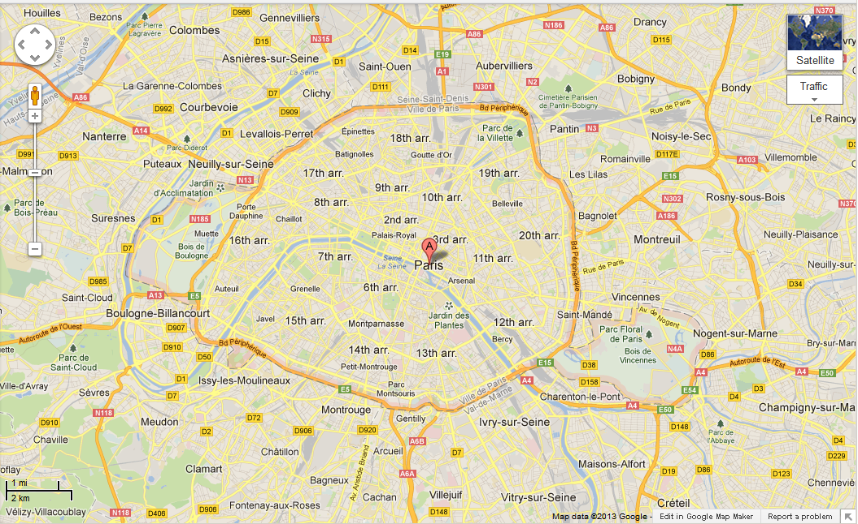
Map

Slide 3
Transportation
Transportation | Budget
Airfare x (family) | $0.00
Airfare Parking at Airport | $0.00
Car Rental | $0.00
Gas (going) [price x 25/ MPG] | $0.00
Gas (coming home) [price x 25/ MPG] | $0.00
Bus Tickets | $0.00
Train | $0.00
Other | $0.00
Total | $0.00
Figure out gas:
Find miles (google Maps)
Divide miles by 25
Take that number x gas price

Slide 4
Lodging
Lodging | Budget
Hotels $ x how many nights Moevenpick Hotel Paris Neuilly Not staying in the same place? Sunday Monday Tuesday Wednesday Thursday Friday Saturday | $1704.00
Other | $0.00
Total | $1704.00

Slide 5
Extra Expense
Extra expenses | Budget
Souvenirs ($20.00 x 4 of people) x 4 of purchases | $320.00
Snacks ($5.00 x 4 of people) x 6 of purchases | $120.00
Emergency cash | $36.00
Total | $476.00

Slide 6
Itinerary
Total Expense: $196.00
Saturday, June 8th | Where | How Much?
Breakfast | Berthillon 4x13 | $52.00
Activity | Walk around | $0.00
Lunch | Le Bio d'Adam et Eve 4x13 | $52.00
Activity | Musee d'Orsay 4x10 | $40.00
Dinner | Pizza Rossi 4x13 | $52.00
Activity | Watch T.V | $0.00

Slide 7
Itinerary
Total Expense: $198.00
Sunday, June 9th | Where | How Much?
Breakfast | Bakery & deli-cafe bread and roses 4x13 | $52.00
Activity | Luxembourg Gardens (Jardin du Luxembourg) | $0.00
Lunch | Zuzu's petals 4x13 | $52.00
Activity | Opera Garnier 12x2+ 9x2 | $42.00
Dinner | Mini Festin 4x13 | $52.00
Activity | Rest or sleep | $0.00

Slide 8
Itinerary
Total Expense: $188.00
Monday, June 10th | Where | How Much?
Breakfast | Pierre Herme 13x4 | $52.00
Activity | Watch T.V | $0.00
Lunch | La Terrasse . 4x13 | $52.00
Activity | Paris Story . 8x4 | $32.00
Dinner | Le Relais de l'Entrecote 4x13 | $52.00
Activity | Sleep | $0.00

Slide 9
Itinerary
Total Expense: $0.00
Tuesday, June 11th | Where | How Much?
Breakfast | L'imprevu . 4x13 | $52.00
Activity | Walk round | $0.00
Lunch | Tea Corner 4x13 | $52.00
Activity |  | $0.00
Dinner |  | $0.00
Activity |  | $0.00

Slide 10
Itinerary
Total Expense: $0.00
Wednesday, June 12th | Where | How Much?
Breakfast |  | $0.00
Activity |  | $0.00
Lunch |  | $0.00
Activity |  | $0.00
Dinner |  | $0.00
Activity |  | $0.00

Slide 11
Itinerary
Total Expense: $0.00
Thursday, June 13th | Where | How Much?
Breakfast |  | $0.00
Activity |  | $0.00
Lunch |  | $0.00
Activity |  | $0.00
Dinner |  | $0.00
Activity |  | $0.00

Slide 12
Itinerary
Total Expense: $0.00
Friday, June 14th | Where | How Much?
Breakfast |  | $0.00
Activity |  | $0.00
Lunch |  | $0.00
Activity |  | $0.00
Dinner |  | $0.00
Activity |  | $0.00

Slide 13
Itinerary
Total Expense: $0.00
Saturday, June 15th | Where | How Much?
Breakfast |  | $0.00
Activity |  | $0.00
Lunch |  | $0.00
Activity |  | $0.00
Dinner |  | $0.00
Activity |  | $0.00

