Slide 1
Paris, France
Traveling June 8-15 2013
Planned By:
Reagan Patterson

Slide 2
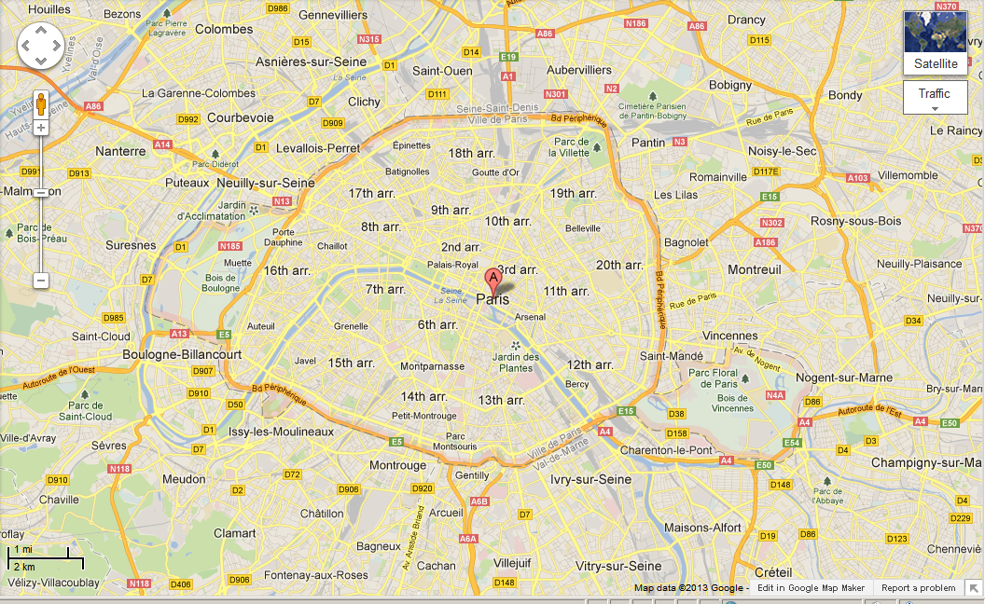
Map

Slide 3
Transportation
Transportation | Budget
Airfare x (family) $2,882x4 | $11,528
Airfare Parking at Airport | $50
Car Rental | $126
Gas (around France) [price x 25/ MPG] | $44.32
Gas (coming home) [price x 25/ MPG] | $0.00
Bus Tickets | $0.00
Train | $0.00
Other | $0.00
Total | $0.00
Figure out gas:
Find miles (google Maps)200
Divide miles by 25=8
Take that number x gas price $5.54x8

Slide 4
Lodging
Lodging | Budget
Hotels $ x how many nights Paris Marriott Rive Gauche Hotel Conference Center $562x6 Not staying in the same place? Sunday Monday Tuesday Wednesday Thursday Friday Saturday | $3372.00
Other | $3372.00
Total | $.00

Slide 5
Extra Expense
Extra expenses | Budget
Souvenirs ($10.00 x 4 of people) x 4 of purchases | $160.00
Snacks ($6.00 x 4 of people) x 7 of purchases | $168.00
Passport $165x2=330 $120x2=240 | $570.00
Emergency cash | $100.00
Total | $998.00

Slide 6
Itinerary
Total Expense: $132.00
Saturday, June 8th | Where | How Much?
Breakfast | McDonalds $7x4=$28 | $28.00
Activity | Exploring the hotel | $0.00
Lunch | Aux Ministeres $10x4=$40 | $40.00
Activity | Musee d'Orsay $8x4=$32 | $32.00
Dinner | Restaurant de la Tour $8x4=32 | $32.00
Activity | Pont Alexandre III | $0.00

Slide 7
Itinerary
Total Expense: $0.00
Sunday, June 9th | Where | How Much?
Breakfast | Strada Cafe $13x4 | $52.00
Activity |  | $0.00
Lunch | Patati Patata $10x4=$40 | $40.00
Activity |  | $0.00
Dinner | Esens'All $74x4=$296 | $296.00
Activity |  | $0.00

Slide 8
Itinerary
Total Expense: $0.00
Monday, June 10th | Where | How Much?
Breakfast | Les Papilles $90x4=$360 | $360.00
Activity |  | $0.00
Lunch | Pizza Rossi $16x4 | $64.00
Activity |  | $0.00
Dinner | Au Petit Sud Ouest $58x4=$232 | $232.00
Activity |  | $0.00

Slide 9
Itinerary
Total Expense: $0.00
Tuesday, June 11th | Where | How Much?
Breakfast | Le Diane $140x4=$560 | $560.00
Activity |  | $0.00
Lunch |  | $0.00
Activity |  | $0.00
Dinner |  | $0.00
Activity |  | $0.00

Slide 10
Itinerary
Total Expense: $0.00
Wednesday, June 12th | Where | How Much?
Breakfast | Paul Chene $120x4=$480 | $480.00
Activity |  | $0.00
Lunch |  | $0.00
Activity |  | $0.00
Dinner |  | $0.00
Activity |  | $0.00

Slide 11
Itinerary
Total Expense: $0.00
Thursday, June 13th | Where | How Much?
Breakfast | Le Grenier a Pain $50x4=$200 | $200.00
Activity |  | $0.00
Lunch |  | $0.00
Activity |  | $0.00
Dinner |  | $0.00
Activity |  | $0.00

Slide 12
Itinerary
Total Expense: $0.00
Friday, June 14th | Where | How Much?
Breakfast | L'Astrance $100x4=$400 | $400.00
Activity |  | $0.00
Lunch | Blueberry $50x4=$200 | $200.00
Activity |  | $0.00
Dinner |  | $0.00
Activity |  | $0.00

Slide 13
Itinerary
Total Expense: $208.00
Saturday, June 15th | Where | How Much?
Breakfast | La Mere Michele $45x4=$180 | $180.00
Activity | pool | $0.00
Lunch | McDonalds $7x4=$28 | $28.00
Activity | Sleep on plane | $0.00
Dinner | At home | $0.00
Activity | sleep | $0.00

