Slide 1
Vancouver, Canada
Traveling June 8-15 2013
Planned By:
Travis Hermel

Slide 2
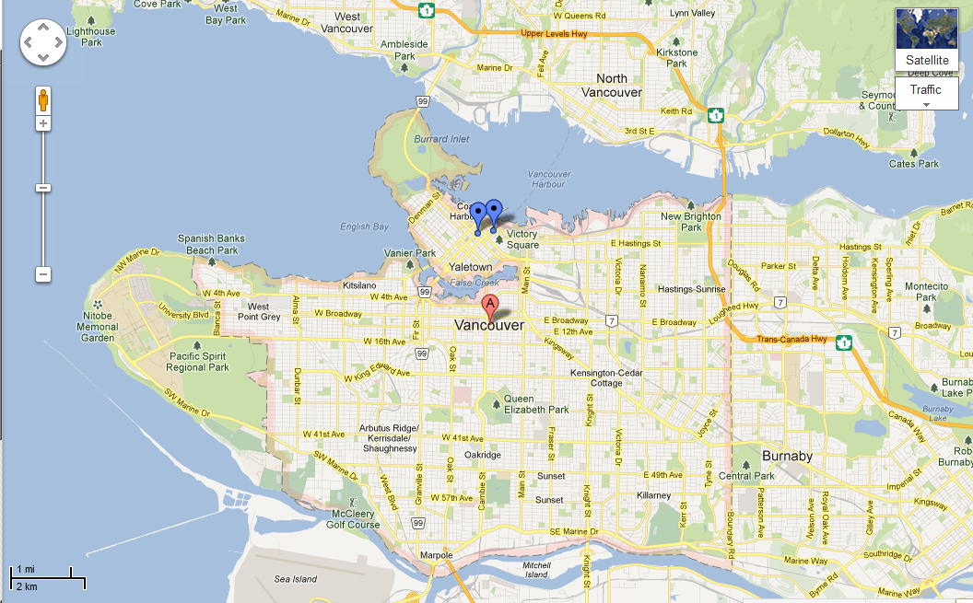
Map

Slide 3
Transportation
Transportation | Budget
Airfare x (family) 448 x 4 = | $36,04.00
Airfare Parking at Airport | $0.00
Car Rental | $0.00
Gas (going) [price x 25/ MPG] | $0.00
Gas (coming home) [price x 25/ MPG] | $0.00
Bus Tickets | $0.00
Train | $0.00
Other | $0.00
Total | $0.00
Figure out gas:
Find miles (google Maps)
Divide miles by 25
Take that number x gas price

Slide 4
Lodging
Lodging | Budget
Hotels $ x how many nights The Sutton Place Hotel $203x4= Not staying in the same place? Sunday Monday Tuesday Wednesday Thursday Friday Saturday | $812.00
Other | $0.00
Total | $812.00

Slide 5
Extra Expense
Extra expenses | Budget
Souvenirs ($10.00 x 4 of people) x 2 of purchases | $80.00
Snacks ($5.50 x 4 of people) x 6 of purchases | $21.00
Emergency cash | $100.00
Total | $201.00

Slide 6
Itinerary
Total Expense: $134.04
Saturday, June 8th | Where | How Much?
Breakfast | McDonalds 3x$7.00 | $28.00
Activity | Flying | $36.04
Lunch | Airline Food | $0.00
Activity | B.C. Place Stadium . 2x8.00 2x5.00 | $26.00
Dinner | The Oakwood Canadian Bistro 4x11.00 | $44.00
Activity | Hotel relaxing | $0.00

Slide 7
Itinerary
Total Expense: $0.00
Sunday, June 9th | Where | How Much?
Breakfast | Hotel Food | $0.00
Activity | Touring the City | $0.00
Lunch | Moki Pizza 19x4 | $76.00
Activity | Vancouver Aquarium $12.76x2=25.52 $22.79x2= 45.58 | $0.00
Dinner |  | $0.00
Activity | Hotel relaxing | $0.00

Slide 8
Itinerary
Total Expense: $0.00
Monday, June 10th | Where | How Much?
Breakfast | Hotel Food | $0.00
Activity | Touring the City | $0.00
Lunch |  | $0.00
Activity | Touring the City | $0.00
Dinner |  | $0.00
Activity | sleep | $0.00

Slide 9
Itinerary
Total Expense: $0.00
Tuesday, June 11th | Where | How Much?
Breakfast | Hotel Food | $0.00
Activity | Touring the City | $0.00
Lunch |  | $0.00
Activity | Touring the City | $0.00
Dinner |  | $0.00
Activity | sleep | $0.00

Slide 10
Itinerary
Total Expense: $0.00
Wednesday, June 12th | Where | How Much?
Breakfast | Hotel Food | $0.00
Activity | Touring the City | $0.00
Lunch |  | $0.00
Activity | Touring the City | $0.00
Dinner |  | $0.00
Activity | sleep | $0.00

Slide 11
Itinerary
Total Expense: $0.00
Thursday, June 13th | Where | How Much?
Breakfast | Hotel Food | $0.00
Activity |  | $0.00
Lunch |  | $0.00
Activity |  | $0.00
Dinner |  | $0.00
Activity | sleep | $0.00

Slide 12
Itinerary
Total Expense: $0.00
Friday, June 14th | Where | How Much?
Breakfast | Hotel Food | $0.00
Activity |  | $0.00
Lunch |  | $0.00
Activity |  | $0.00
Dinner |  | $0.00
Activity | sleep | $0.00

Slide 13
Itinerary
Total Expense: $8530.14
Saturday, June 15th | Where | How Much?
Breakfast | Hotel Food | $0.00
Activity | drive | $0.00
Lunch | Mc Donalds | $28.00
Activity | Flying | $36,04.00
Dinner | Airline food | $0.00
Activity | sleep | $0.00

