Slide 1
Paris, France
Traveling June 8-15 2013
Planned By:
Vinnie Molina

Slide 2
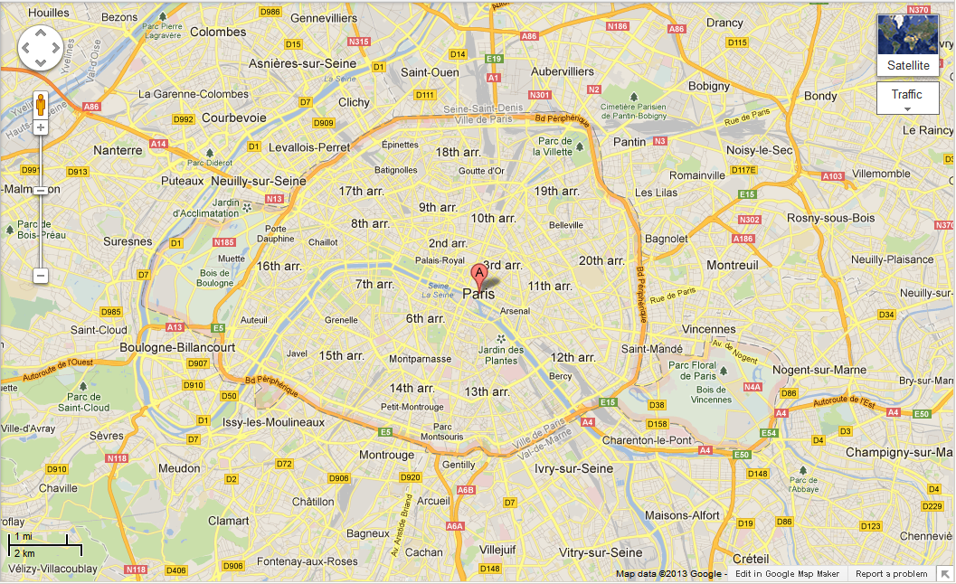
Map

Slide 3
Transportation
Transportation | Budget
Airfare $2,882 x6 | $17,292
Airfare Parking at Airport | $0.00
Car Rental | $0.00
Gas (going) [price x 25/ MPG] | $0.00
Gas (coming home) [price x 25/ MPG] | $0.00
Bus Tickets | $0.00
Train | $0.00
Other | $0.00
Total | $17,292.00
Figure out gas:
Find miles (google Maps)
Divide miles by 25
Take that number x gas price

Slide 4
Lodging
Lodging | Budget
Hotels $ x how many nights $456x2= $912x6 Pullman Paris Charles De Gaulle Airport Not staying in the same place? Sunday Monday Tuesday Wednesday Thursday Friday Saturday | $5,472.00
Other | $0.00
Total | $5472.00

Slide 5
Extra Expense
Extra expenses | Budget
Souvenirs ($20.00 x 6 of people) x 1 of purchases | $120.00
Snacks ($5.00 x 6 of people) x 7 of purchases | $210.00
Emergency cash | $200.00
Passport 165x5=825 120x1=120 | $945.00
Total | $1475.00

Slide 6
Itinerary
Total Expense: $1050.00
Saturday, June 8th | Where | How Much?
Breakfast | Firehouse Subs 10x6=60 | $60.00
Activity | Flying in a plane | $0.00
Lunch | Le Restaurant . $140x6 | $840.00
Activity | Exploring the hotel | $0.00
Dinner | Le 114 Faubourg 25x6=150 | $150.00
Activity | Playing Call of Duty Black ops | $0.00

Slide 7
Itinerary
Total Expense: $1020.00
Sunday, June 9th | Where | How Much?
Breakfast | Blueberry 50x6 | $300.00
Activity | Gym | $0.00
Lunch | Ciasa Mia 100x6 | $600.00
Activity | pool | $0.00
Dinner | Pizza Rossi . 20x6 | $120.00
Activity | Watching TV | $0.00

Slide 8
Itinerary
Total Expense: $1608.00
Monday, June 10th | Where | How Much?
Breakfast | Au Petit Sud Ouest 58x6 | $348.00
Activity | sleeping | $0.00
Lunch | Les Papilles 70x6 | $420.00
Activity | Playing black ops | $0.00
Dinner | Le Diane . 140x6 | $840.00
Activity | Gym | $0.00

Slide 9
Itinerary
Total Expense: $0.00
Tuesday, June 11th | Where | How Much?
Breakfast | Esens'All . | $0.00
Activity | pool | $0.00
Lunch | L'Astrance 70x6 | $420.00
Activity | Gym | $0.00
Dinner | Le Grenier a Pain 50x6 | $300.00
Activity | sleeping | $0.00

Slide 10
Itinerary
Total Expense: $0.00
Wednesday, June 12th | Where | How Much?
Breakfast |  | $0.00
Activity |  | $0.00
Lunch |  | $0.00
Activity |  | $0.00
Dinner |  | $0.00
Activity |  | $0.00

Slide 11
Itinerary
Total Expense: $0.00
Thursday, June 13th | Where | How Much?
Breakfast |  | $0.00
Activity |  | $0.00
Lunch |  | $0.00
Activity |  | $0.00
Dinner |  | $0.00
Activity |  | $0.00

Slide 12
Itinerary
Total Expense: $0.00
Friday, June 14th | Where | How Much?
Breakfast |  | $0.00
Activity |  | $0.00
Lunch |  | $0.00
Activity |  | $0.00
Dinner |  | $0.00
Activity |  | $0.00

Slide 13
Itinerary
Total Expense: $0.00
Saturday, June 15th | Where | How Much?
Breakfast |  | $0.00
Activity |  | $0.00
Lunch |  | $0.00
Activity |  | $0.00
Dinner |  | $0.00
Activity |  | $0.00

